Slide 1


Theta-driven syllable parsing in decoding speech Oded Ghitza Boston University
Funded by a research grant
from

Slide 2
On the role of theta-driven syllabic parsing in decoding speech: intelligibility of speech with a manipulated modulation spectrum

Slide 3
Introduction
Recent hypotheses on the potential role of neuronal oscillations in speech perception propose that speech is processed on multi-scale temporal analysis windows formed by a cascade of neuronal oscillators locked to the input pseudo-rhythm. In particular, Ghitza (2011) proposed that the oscillators are in the theta, beta and gamma frequency bands with the theta oscillator the master, tracking the input syllabic rhythm and setting a time-varying, hierarchical window structure synchronized with the input.

Slide 4
Introduction – Cont.
In the study described here the hypothesized role of theta was examined by measuring the intelligibility of speech with a manipulated modulation spectrum. Each critical-band signal was manipulated by controlling the degree of temporal-envelope flatness. Intelligibility of speech with critical-band envelopes that are flat is poor; inserting extra information, restricted to the input syllabic rhythm, markedly improves intelligibility.

Slide 5
Introduction – Cont.
It is concluded that flattening the critical-band envelopes prevents the theta oscillator from tracking the input rhythm, hence the disruption of the hierarchical window structure that controls the decoding process. Reinstating the input-rhythm information revives the tracking capability, hence the synchronization between the window structure and the input, resulting in the extraction of additional information from the flat modulation spectrum.

Slide 6
Tempo
Figure 1 – A block diagram of the Tempo model. It comprises lower and upper paths that process the sensory stream generated by a model of the auditory periphery. The lower path extracts parsing information, which controls the decoding process performed in the upper path. The parsing is expressed in the form of a time-varying, hierarchical window structure, realized as an array of cascaded oscillators locked to the input syllabic rhythm; the frequencies and relative phases of the oscillations determine the temporal windows (location and duration) that control the decoding process.

Slide 7
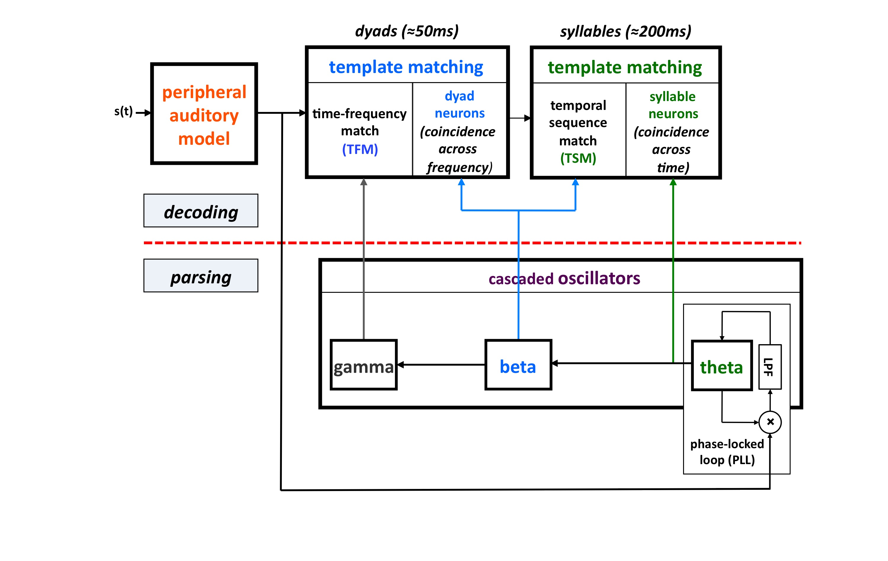
Fig. 1

Slide 8
The Pulse Position Coding (PPC) System
Figure 2 – (a) A block diagram of the Peak Position Coding (PPC) system used in Experiment I. The signal at the system output is the linear sum of all critical-band channels. The core experimental conditions are defined by the operator O. (b) The Control condition. Operator O₁ is a low-pass filter, with a cutoff frequency of 10 Hz. (c) The No-Theta (Noϴ) condition. Operator O₂ is a stop-band filter with a 2–9 Hz frequency gap. (d) The Channel-Theta (Chϴ) condition. Operator O₃ comprises a linear low-pass filter (cutoff frequency of 10 Hz) followed by a peak picking operation. The pulse train represents, in a minimalistic form, the input rhythm information at this frequency channel. See text for details.

Slide 9
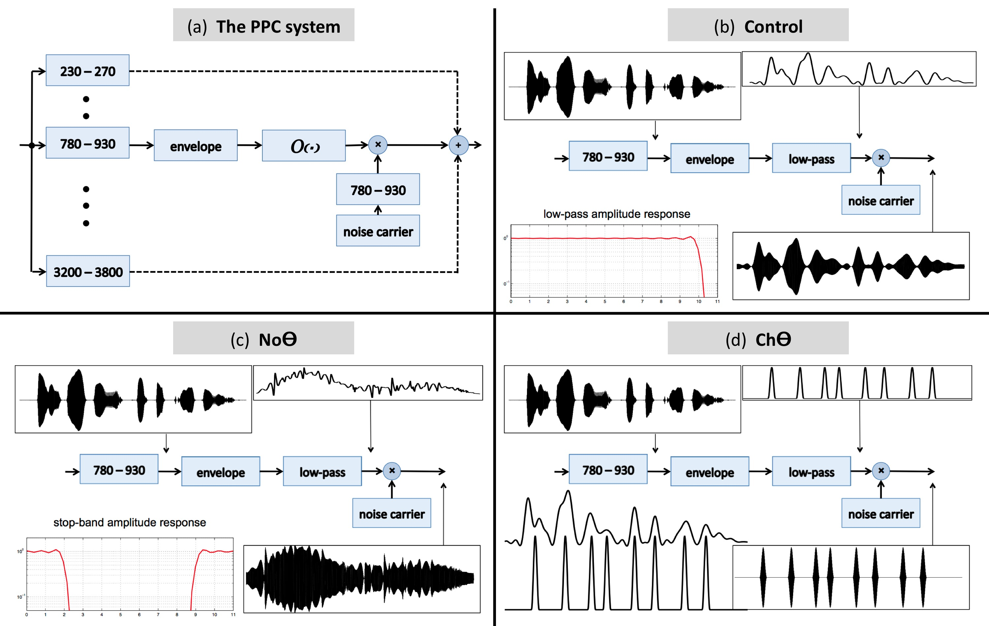
Fig. 2

Slide 10
Channel-Theta vs. Global-Theta
Figure 3 – Illustration of the PPC strategies used in Experiment I. (a) A spectrogram of the stimulus used for panels (b) and (c). Abscissa is time and the ordinate is frequency, in linear scale. (b) A Chϴ strategy. Pulses are placed at the peak location of the filtered critical-band envelopes. Abscissa is time and the ordinate is critical-band (i.e. frequency in a critical-band scale). Note the curvature in the pulse contours, indicating a residue of spectro-temporal information. (c) A Global-Theta (Glbϴ) strategy. A single pulse train is generated, same for all channels, with pulses at the mid-vowel locations obtained by hand-segmenting the full band signal. Note that the location of the mid-vowel is loose, within a time-interval in the order of a few pitch cycles.

Slide 11
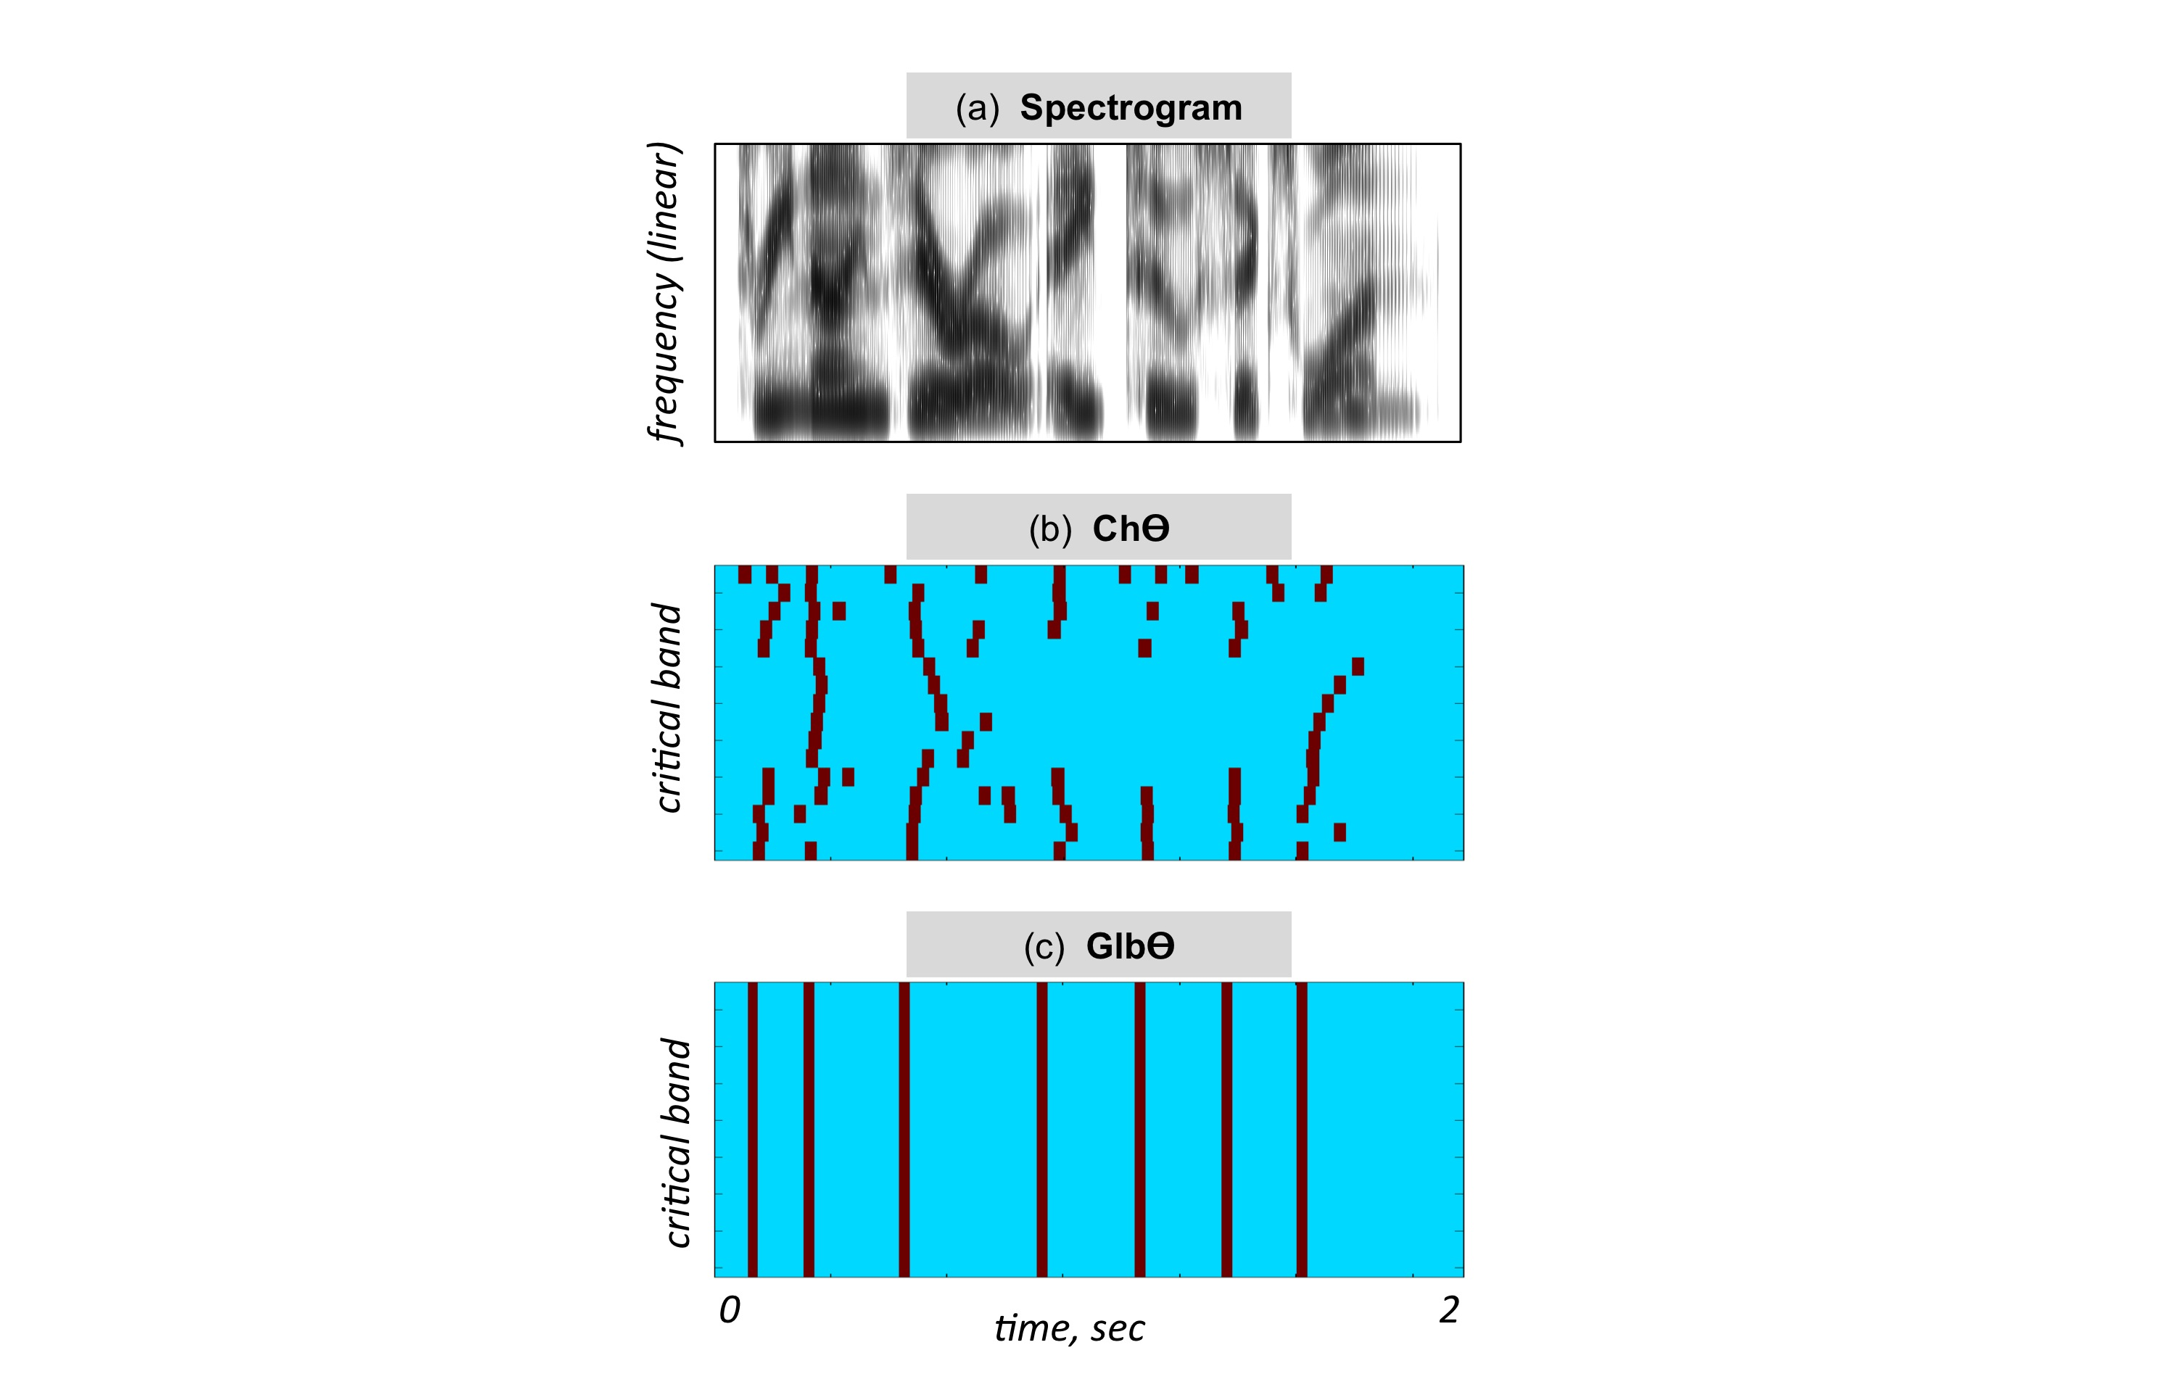
Fig. 3

Slide 12
Stimuli Produce by the PPC System
Figure 4 – Waveforms (left hand side) and spectrograms (right hand side) generated by the PPC system. The stimuli are 4 KHz wide. The frequency range of the spectrograms is 0–5 KHz.

Slide 13
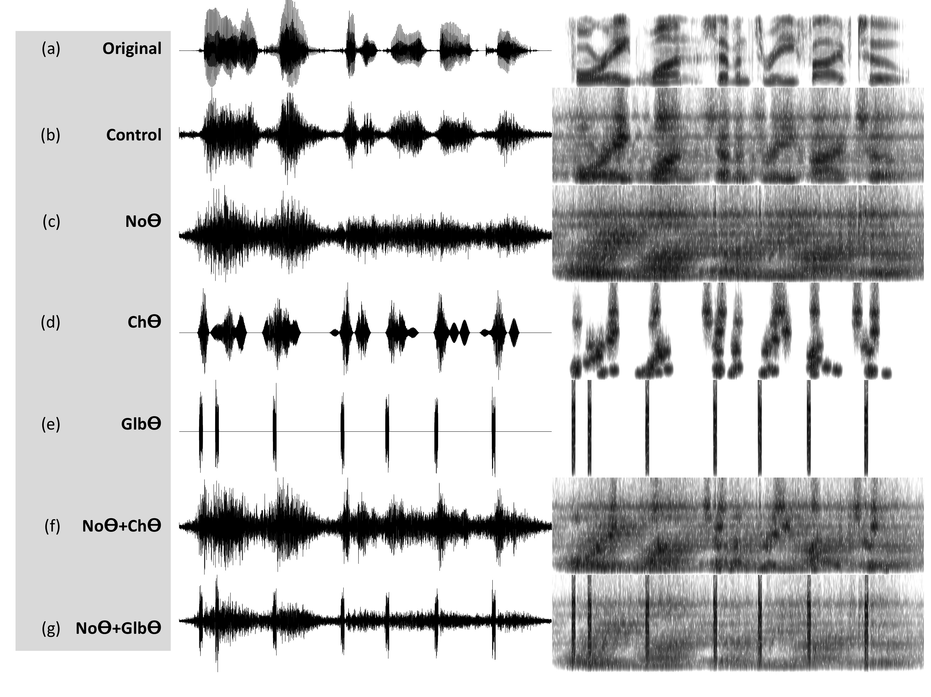

Slide 14
The Infinite Clipping (InfC) System – I
Figure 5 – A block diagram of the Infinite Clipping (InfC) system used in Experiment II. The signal at the system output is the linear sum of all critical-band channels. The system is a generalization of a design used by Licklider and Pollack (1948), where an infinite-clipping operator was applied to the full-band signal. Here, the infinite-clipping operation is applied to each critical-band output (prior to summation). The parameter Gain determines the degree of critical-band envelope flatness.

Slide 15
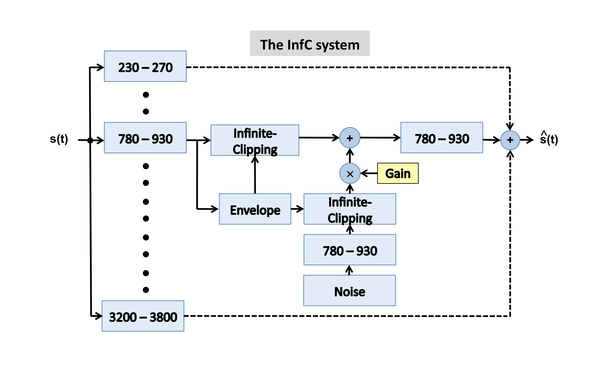
Fig. 5

Slide 16
The Infinite Clipping (InfC) System – II
Figure 6 – An illustration of the signal flow in one critical-band channel of the system in Fig. 5 for G=1 (right column) and G=0.5 (left column). Panels (a) to (c) are same in both columns. (a) The envelope of a band-limited signal, low-pass filtered to 10 Hz. (b) InfC(S) is the binary output of an infinite-clipping operator, operating on non-zero signal intervals – intervals with a signal above a prescribed fixed threshold (panel (a), red horizontal line). (c) InfC(N) is the binary output of an infinite-clipping operator operating on band-limited noise, only inside the gaps in between non-zero signal intervals. (d) The sum of panels (b) and (c), with Gain values G=0.5 (left) and G=1 (right). The channel output is the signal of panel (d), band-pass filtered by a postfilter identical to the channel critical-band filter. (e) The envelope of the channel output, in red, overlaid on top of the blue curve from panel (a).

Slide 17
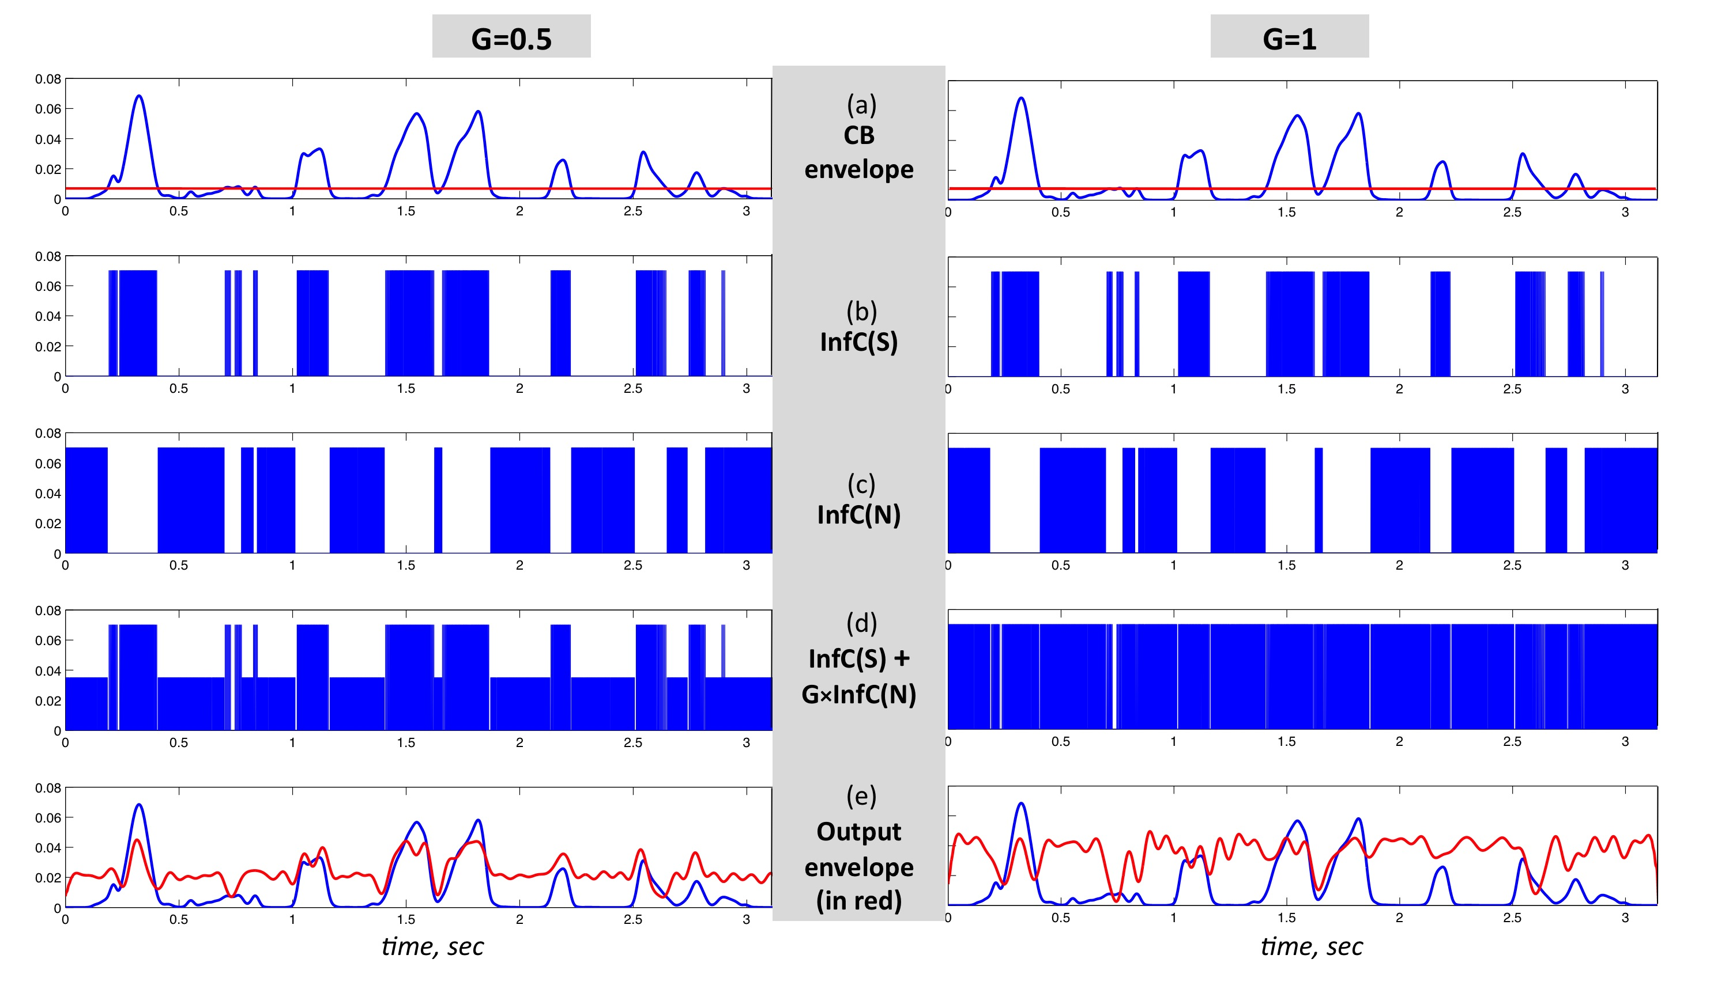
Fig. 6

Slide 18
Stimuli Produce by the InfC System
Figure 7 – Waveforms (left hand side) and spectrograms (right hand side) generated by the InfC system. The stimuli are 4 KHz wide. The frequency range of the spectrograms is 0–5 KHz.

Slide 19
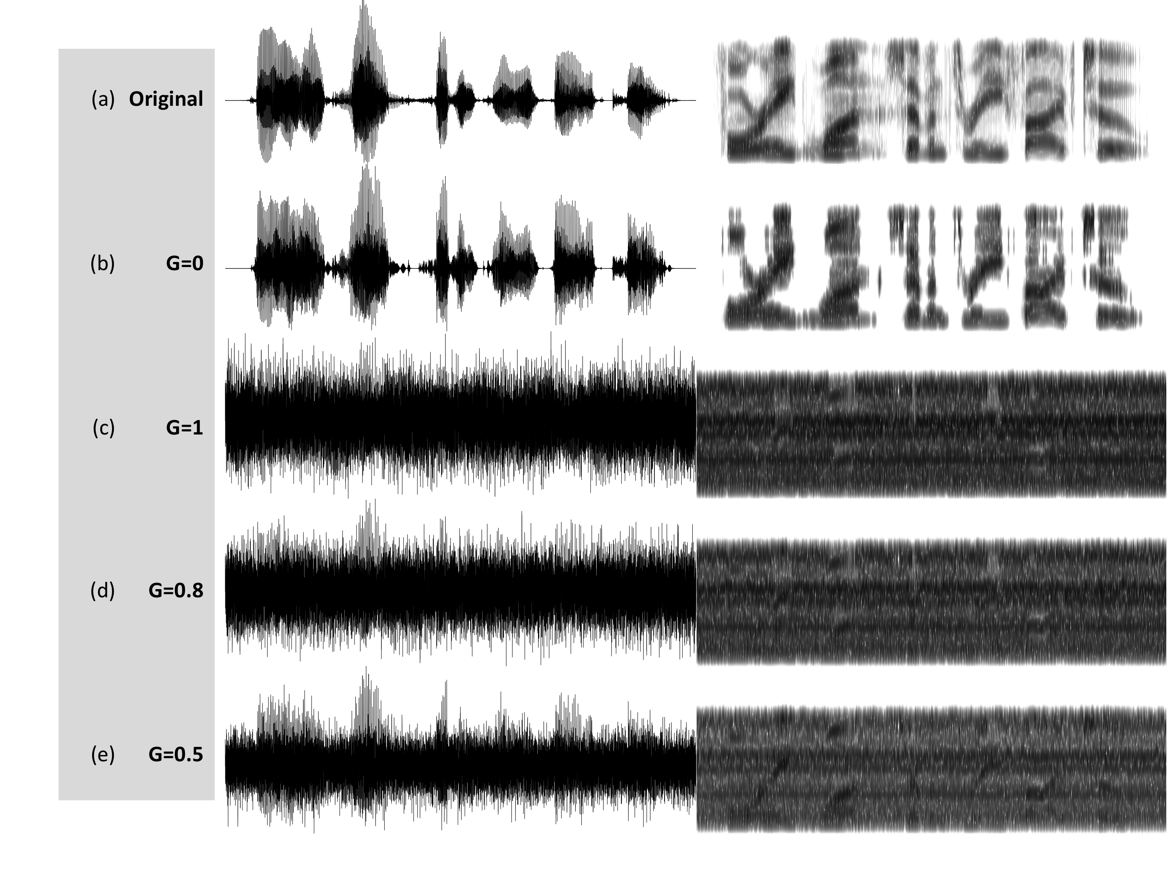

Slide 20
Corpus
The experimental corpus comprised 100 digit strings spoken fluently by a male speaker. Each string is a 7-digit sequence and is approximately 2 seconds long. It is uttered as a phone number in an American accent, i.e. a cluster of 3 digits followed by a cluster of 4 digits (for example: “two six two, seven O one eight”). It is a low perplexity corpus (a vocabulary of 11 words, 0 to 9 and O) but without contextual information. For each signal-manipulation condition, 80 stimuli (out of 100) were chosen at random and concatenated in a sequence: [alert tone] [digit string] [5-sec long silence gap] [alert tone] …

Slide 21
Paradigm
Subjects were instructed to listen to a digit string once and, during the 5-sec long gap following the stimulus, to type into an electronic file the last 4 digits heard, in the order presented (always 4 digits, even those that she/he was uncertain about).

Slide 22
Results – Experiment I
Figure 8 – Experiment I. Error rates (a) and Normalized error rates (b) for conditions Control, Noϴ, Noϴ+Chϴ and Noϴ+Glbϴ. Two error metrics, digit- and string-error, are used. Adding Chϴ or Glbϴ stimulus to the corresponding Noϴ stimulus improves intelligibility. Normalized error patterns indicate strong degree of consistency across subjects for the Noϴ vs. Noϴ+Chϴ contrast. A drop in the degree of consistency is noticed for the Noϴ vs. Noϴ+Glbϴ contrast.

Slide 23
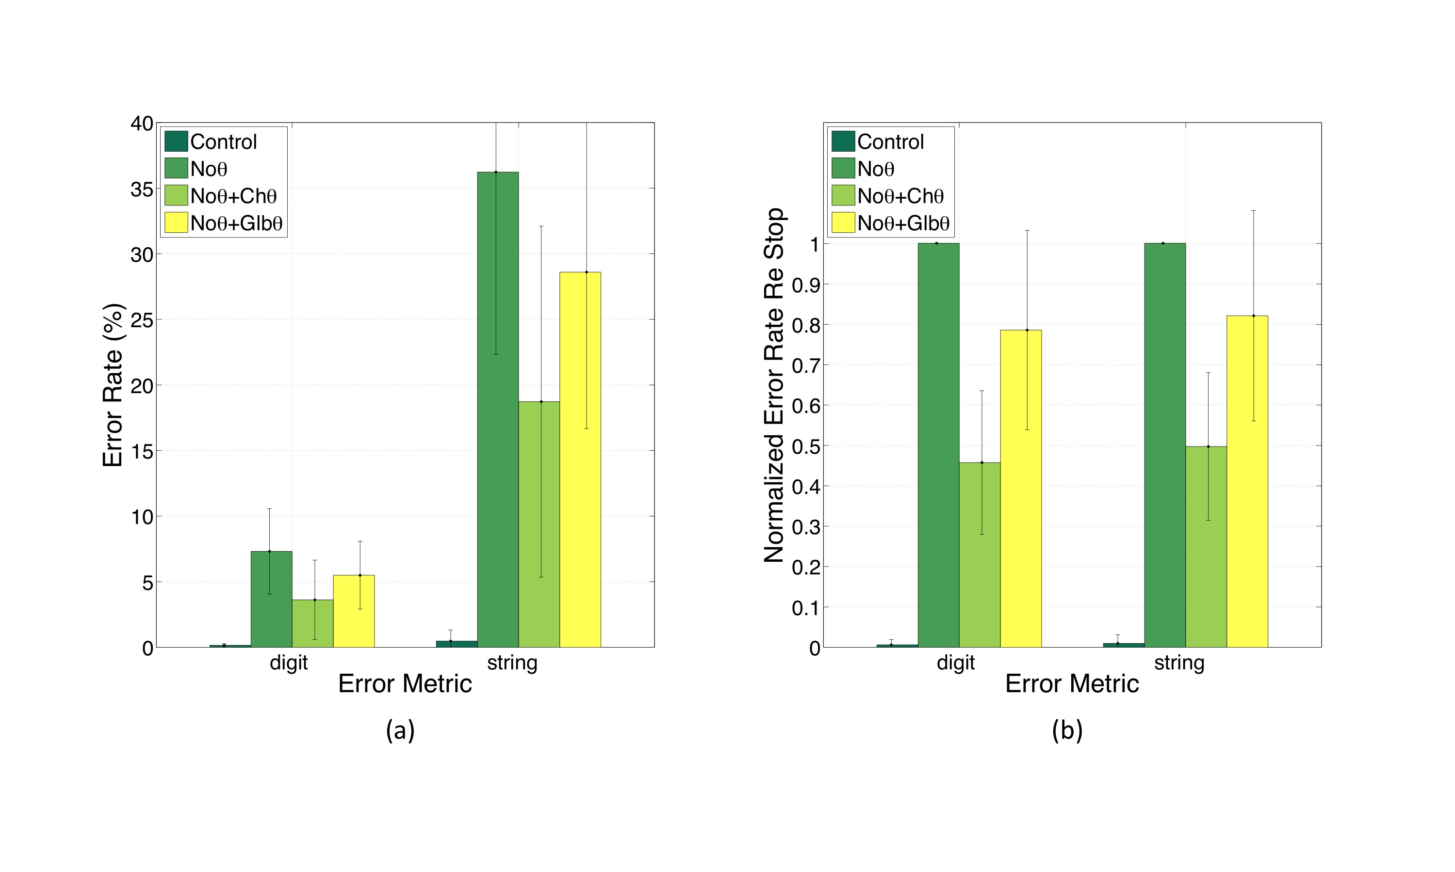
Fig. 8

Slide 24
Results – Experiment I
Figure 9 – Experiment II. Error rates (a) and Normalized error rates (b) for conditions G=0, =1, =0.8 and =0.5. Two error metrics, digit- and string-error, are used. Reducing gain (i.e., reinstating critical-band envelope fluctuations) markedly improves intelligibility. Improvement is due exclusively to the recovered function of syllabic parsing. Note the consistency of normalized error patterns across subjects, and the similarity in patterns between the digit- and string-error metrics.

Slide 25
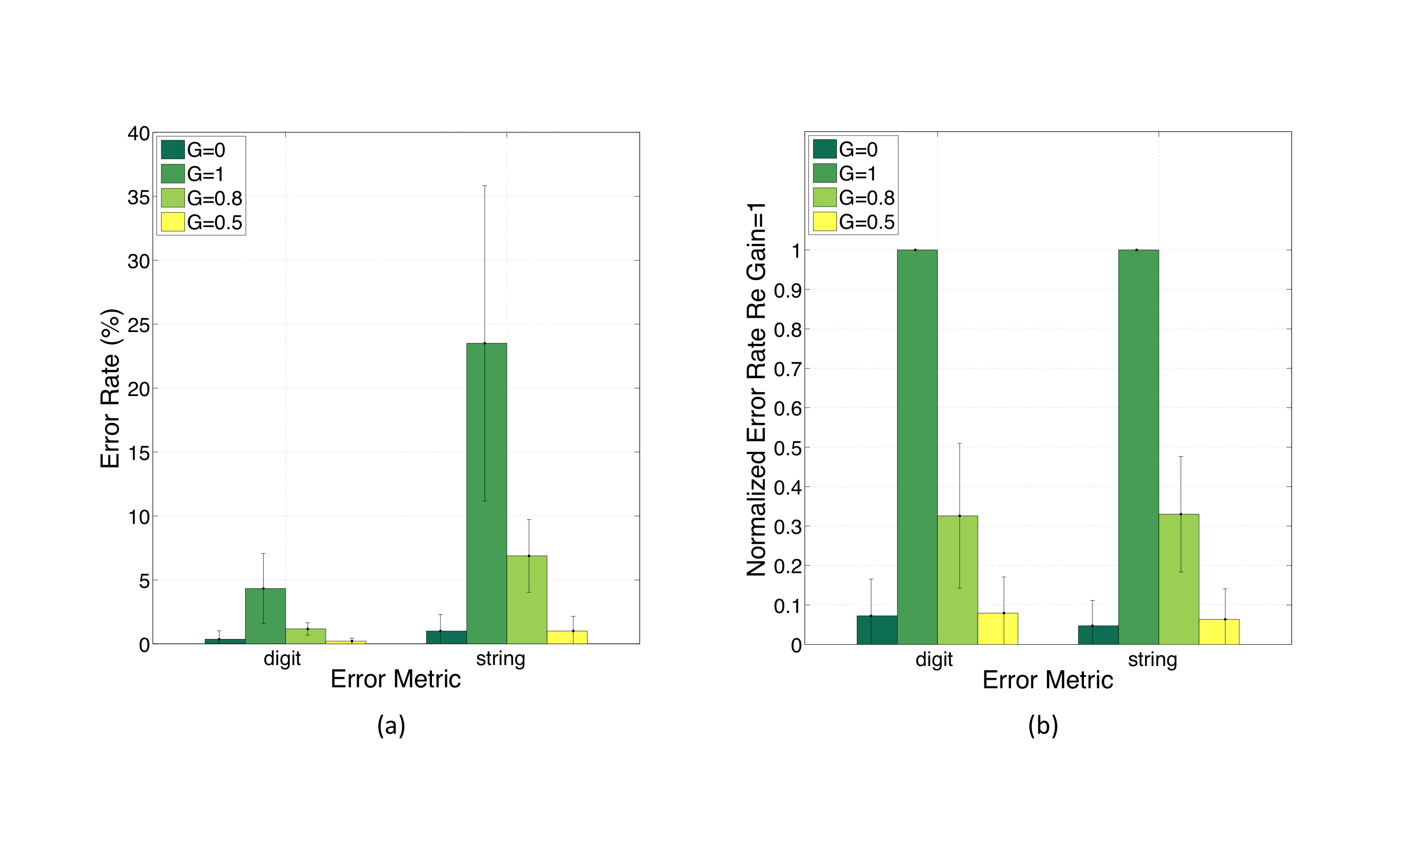
Fig. 9

Slide 26
Analysis of Variance (ANOVA)
Table 1 – A post-hoc Tukey/Kramer test, performed independently on each of the data sets behind the figures listed in the left column, and per error-metric.

Slide 27
Summary
Intelligibility (in terms of digit and string error rates) of the last four digits in 7-digit sequences was measured as a function of changes in critical-bands envelope flatness. We found that the intelligibility of stimuli with flat critical-band envelopes is poor. The addition of extra information, restricted to the input syllabic rhythm, markedly improves intelligibility. We suggest that flattening the critical-band envelopes prevents the theta oscillator from tracking the speech pseudo-rhythm, hence disrupting the function of syllabic parsing. We argue that by reinstating the input-rhythm information the tracking capability of the theta oscillator is restored, hence the recovery of synchronization between the input and the hierarchical window structure, which governs the decoding process.

